Slide 1








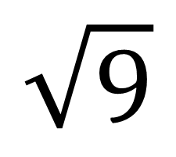
My Measurement Interactive Notebook
Name
Class:
Teacher:
Term 2 Semester 1
Notes:
The aim of this lesson is to revise and confirm the students’ understanding of 2D Shapes in preparation for learning about properties and congruence

Slide 2
Contents
Glossary or Formula Page
Page
Date
Description
2

Slide 3
Tasks
24
7
30
Essential Question
Questions
Notes
Summary
6

Slide 4
Daily 5
What is the Sample Space for a roll of a 6-sided die?
If x=3 what is 2x – 3?
If I draw one bead from a bag holding 3 red beads, 2 blue beads and 5 green beads, what is the probability that I will get a red bead?
What is the perimeter and area of this triangle?
7cm
5cm
4cm
6cm
Notes:
Set

Slide 5
24
7
30
Date
2-D Shapes
EQ – What are the different 2D shapes?
Placemat Activity
Agree on 6 different 2 dimensional shapes.
How would you group them? Why?

Slide 6

24
7
30
Date
2-D Shapes
EQ – What are the different 2D shapes?
How do name shapes?
The names of shapes are based on the number of sides.
triangle has 3 sides
quadrilateral has 4 sides
pentagon has 5 sides
hexagon has 6 sides
Can you think of a common 12-sided shape that you see often?
This is a dodecagon

Slide 7
24
7
30
Date
2-D Shapes
EQ – What are the different 2D shapes?
Placemat Activity
Agree on 6 different 2 dimensional shapes.
How would you group them? Why?
Be prepared to share.

Slide 8

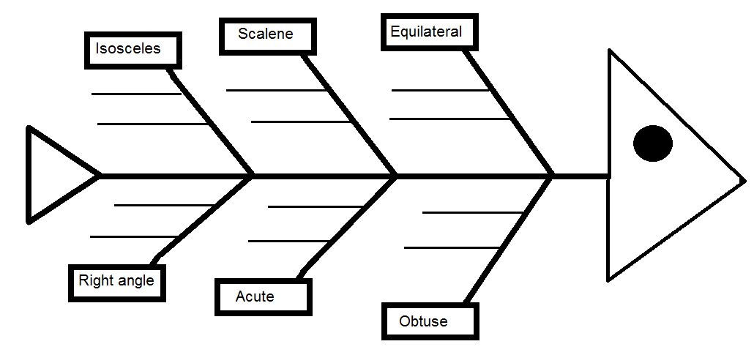
Fish Bone
Complete the fish bone
For types of Triangles
WICOR
Notes:
You can either deliver this as expert groups or just present the notes on the board and have student fill them in
Hand out fish bone template

Slide 9
Isosceles
Two sides are equal
Two angles are equal

Slide 10
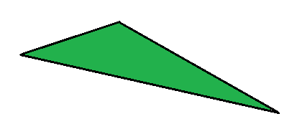
Scalene
No sides equal
No angles equal

Slide 11
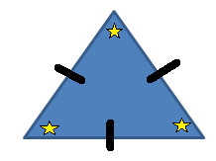

Equilateral
All sides are equal
All Angles are equal

Slide 12
Right angle
One Right Angle (90°)

Slide 13
Acute
Three Acute angles
(less than 90°)

Slide 14
Obtuse
One angle greater than 90°

Slide 15
24
7
30
Date
2-D Shapes
EQ – What are the different 2D shapes?
Angles inside a triangle add up to 180°
Glue your Fish Bone here
5
Notes:
Lesson objective (EQ)

Slide 16

Do you understand? Fists of Five
Notes:
Check for Understanding

Slide 17

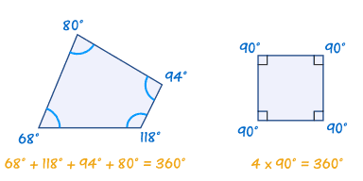
24
7
30
Date:
2-D Shapes
EQ – What are the different 2D shapes?
What is a quadrilateral?
A quadrilateral has four sides and four angles
All the angles add up to 360°

Slide 18


Slide 19
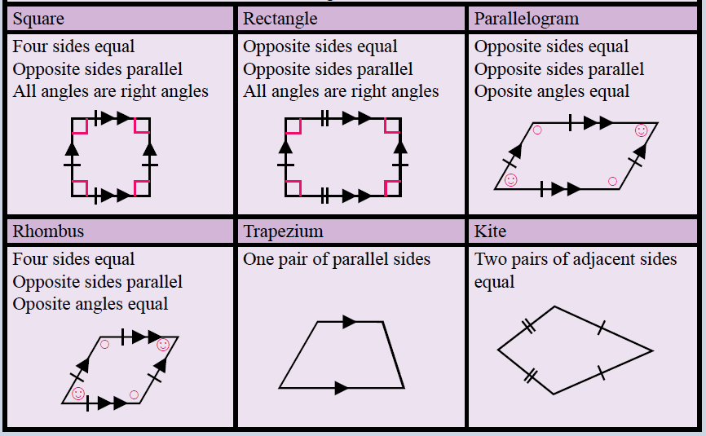
Notes:
Draw a table like the following in your book:

Slide 20
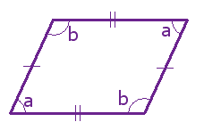
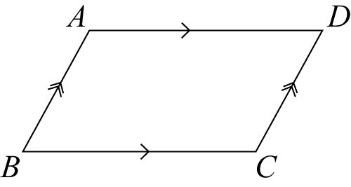
24
7
30
Date:
2-D Shapes
EQ – What are the different 2D shapes?
What are the properties of a parallelogram?
Opposite sides are equal and parallel.
Opposite angles are equal.
a + b = 180°
Alternate angles formed by diagonal line are the same size

Slide 21
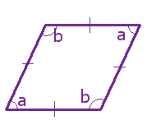
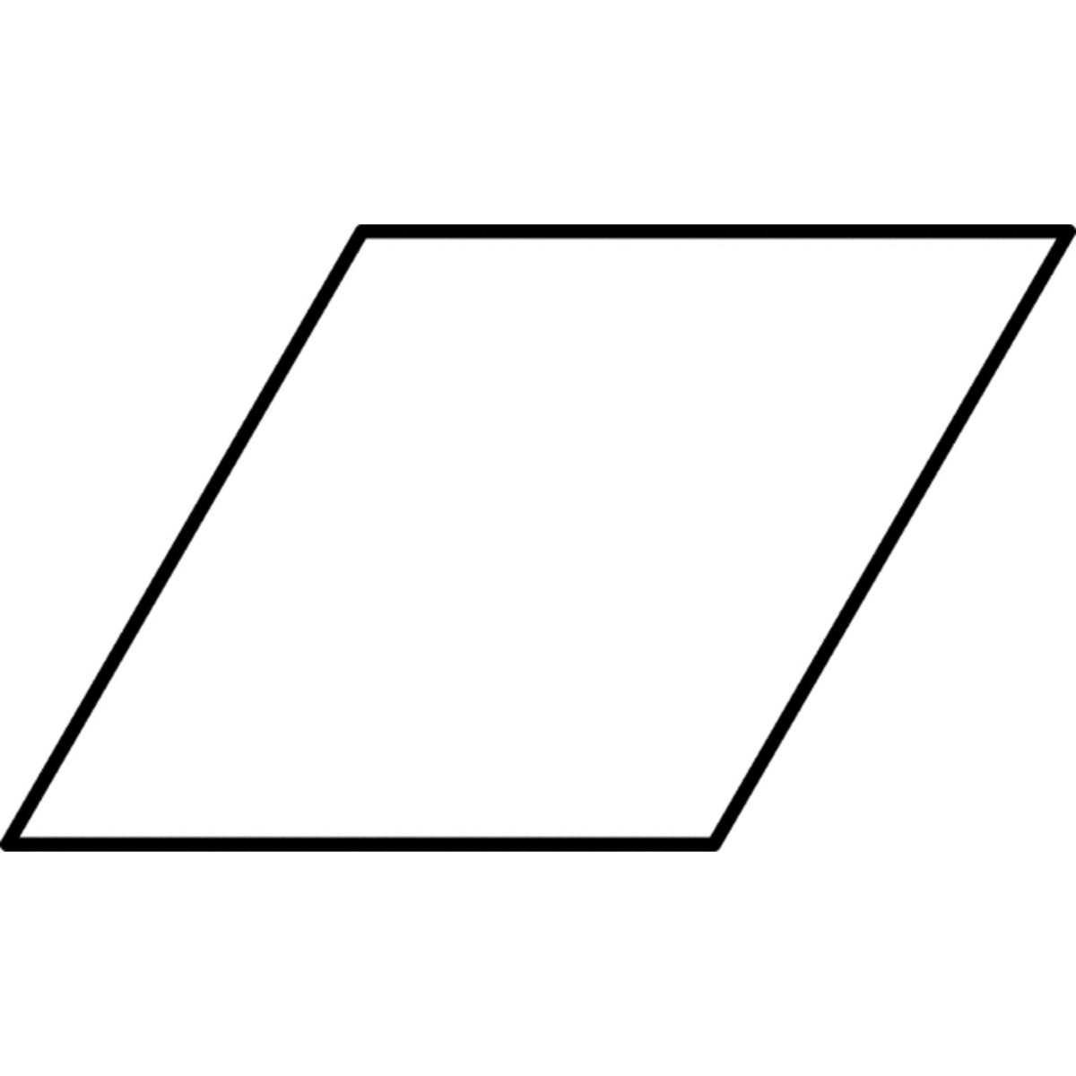
24
7
30
Date:
2-D Shapes
EQ – What are the different 2D shapes?
What are the properties of a rhombus?
Opposite angles are equal
a + b = 180°

Slide 22
Practice
1. Complete the worksheet
WICOR

Slide 23
Exit Pass
WICOR
Name the shape
I have three sides, all sides and angles equal
I have four sides, all sides of equal length
I have three sides, all my angles are less than 90°
I have 4 sides of unequal length, two sides are parallel
Notes:
Closure/ exit pass

Slide 24
Exit Pass
WICOR
Name the shape
I have three sides, all sides and angles equal Equilateral Triangle
I have four sides, all sides of equal length Rhombus (a square is a special case)
I have three sides, all my angles are less than 90° Acute Triangle
I have 4 sides of unequal length, two sides are parallel Trapezium
Notes:
Closure/ exit pass

Slide 25
Notes Review
24, 7 ,30
Date
Title
Essential question
Notes complete
Notes complete with colour and diagrams
Questions completed
Contents page filled in
Formula page filled in

